Slide 1
THE DETROIT CITY POETS ORAL HISTORY PROJECT Presented by Monika Berenyi
In an era characterized by pivotal episodes in American history such as the Civil Rights Movement, Black Arts Movement, Vietnam War, Cold War, and a collapsing automobile industry, Detroit’s artistic community responded with a robust expression of diverse perspectives and artistic forms. The Detroit City Poets Oral History Project explores the history of the poets and independent presses that shaped Detroit’s rich cultural heritage during the 1960s - 1980s.

Slide 2
Objectives
Utilize the value of oral testimony, memory, and community collaboration to facilitate a dynamic perspective on the individuals who shaped Detroit’s literary history in the form of poetry and print culture during the 1960s – 1980s.
Develop content which reflects the integrated nature of a creative movement and its participants, while illuminating the social and spatial significance of Wayne State University and the unique production mechanisms of the presses.
Pursue the project in the context of an artistic practice informed by the disciplines of history, documentary, and archival science.
Stabilize the collected archival materials in a publically accessible repository invested in the preservation and continuity of Detroit’s cultural heritage.

Slide 3
Process: Research and Community Collaboration (2008 – 2012)
In 2008, prompted to create a public art project about the city of Detroit
Elected to challenge contemporaries views by engaging living cultural history
Research
-1960s, poets and independent presses, WSU, Cass Corridor, Boone House
-text: Abandon Automobile (Melba Joyce Boyd and M.L. Liebler, eds., 2001)
-archives: WSU, University of Michigan, private collections
-draft interview questions and personal data sheets
Community Collaboration
-utilize letter writing to establish a dialogue with community members
-conduct oral history interviews (2009-2012)
-public events: MOCAD poetry reading (2009); WSU Cass Exhibition (2011)
-stabilize and digitize archival materials - WSU (2011-2012)
-MACAA Conference (2012)
-public lectures

Slide 4
Content: Poets and Independent Presses
1960s
-The Broadside Press (1965- )
-The Alternative Press (1969-1999)
-The Artists Workshop (1964-1967)
-Trans Love Energies
1970s
-The Lotus Press (1972- )
-The Ridgeway Press (1973- )
-The Red Hanrahan Press (1970-1973)
-One Hundred Pound Press
-Detroit River Press (1977-1983)
-Straits
1980s
-The Past Tents Press (1985- )
1990s
-The Doorjamb Press (1997- )

Slide 5
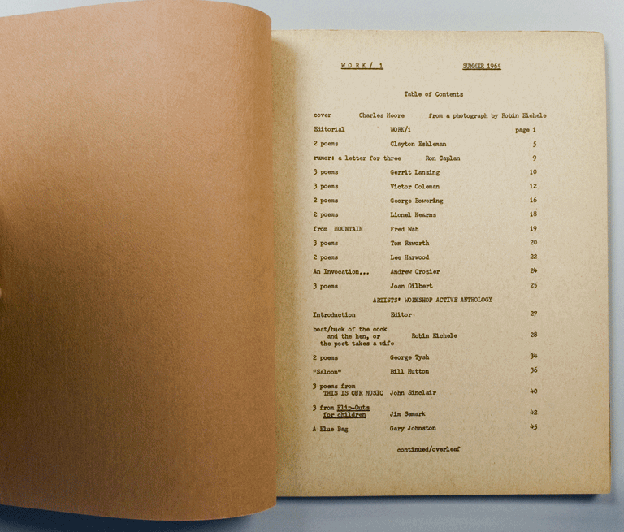
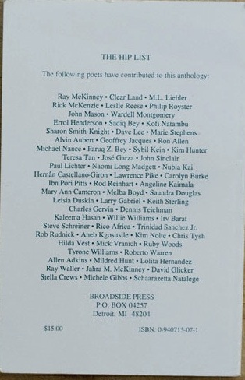
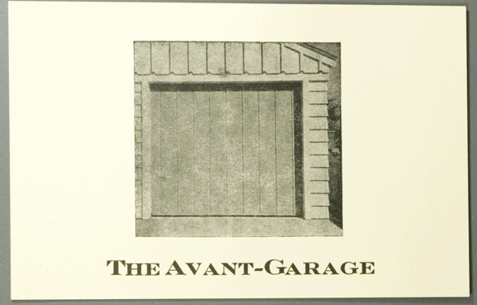
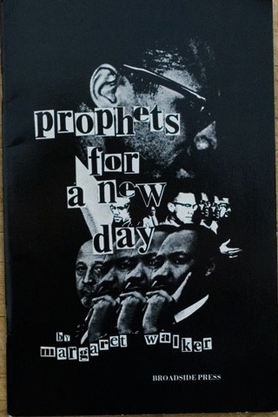
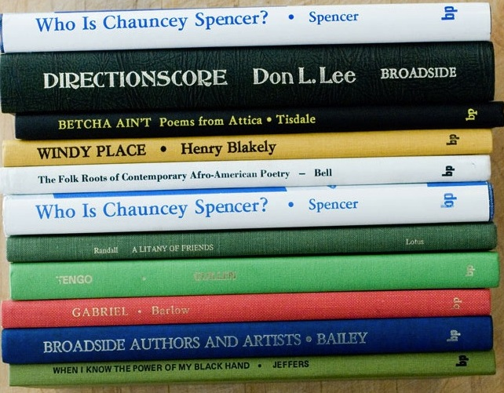
Content: A Synthesis of Culture and Production
Culture
-Detroit’s literary history (1960s - 1980s)
-WSU as cultural epicenter
-activist vocabulary
-working class perspective
-viewpoints of the poets and presses;
leap between the 1960s and the present
Production
-local, collaborative, artistic, rapid
-mimeograph, off-set letterpress, hand-bound
-forms: broadsides, postcards, books, series,
chapbooks, newsletters, pamphlets,
photographs, posters, bumper stickers,
works of art

Slide 6
THE PRESSES

Slide 7
The Artists Workshop
The Artists Workshop was an interracial art collective which functioned in and
around the Cass Corridor between 1964–1967. Spawned at Monteith College
(WSU), the Workshop embodied a belief in experimental education, artistic
collaboration, and independent production. The interdisciplinary nature of the
Workshop resulted in a diverse body of work, reflecting the consciousness of
Detroit’s local musicians, artists and writers. The Workshop is particularly noted
for its extensive mimeographed productions, such as Work and Change, and
jazz-infused poetry readings and performances.
Detroit poets: John Sinclair, Leni Sinclair, Jerry Younkins, Robin Eichele, James
Semark, George Tysh, and others.
National poets: Allen Ginsberg, Ed Sanders, Robert Creeley, and others.

Slide 8
The Artists Workshop (The John And Leni Sinclair Papers, 1957-1999, Bentley Historical Library Archives, University of Michigan)

Slide 9
The Broadside Press
The Broadside Press was established by Dudley Randall in 1965, with the publication of his poem, “The Ballad of Birmingham”. The press became one of the most prolific epicenters for the expression, production, and dissemination of African-American literature while functioning as a critical vehicle to the evolution and visibility of the Black Arts Movement.
Detroit Poets: Dudley Randall, Naomi Long Madgett, Melba Joyce Boyd, Bill Harris,
Hilda Vest, Gloria Aneb House, Albert Ward, Jill Witherspoon Boyer, Michelle Gibbs,
John Sinclair, and others.
National Poets: Gwendolyn Brooks, Nikki Giovanni, Robert Hayden, LeRoi Jones,
Langston Hughes, Etheridge Knight, Don L. Lee, Sonia Sanchez, Margaret Walker,
Margaret Danner, Lance Jeffers, Sterling A. Brown, James A. Emanuel, and others.

Slide 10
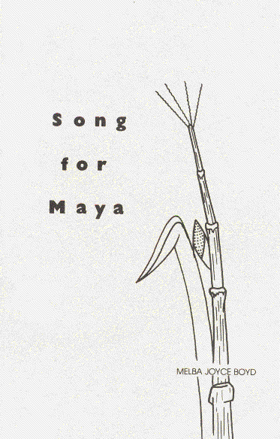
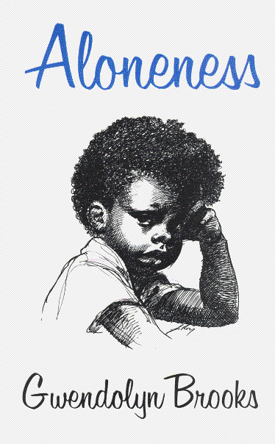
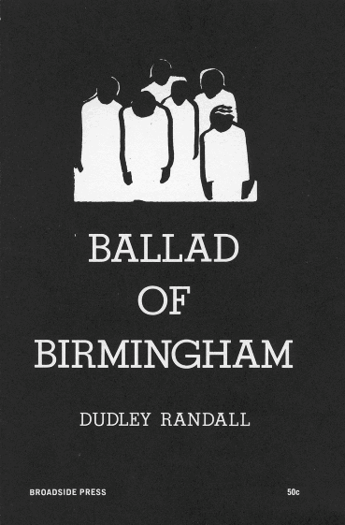
The Broadside Press (Archive of Don and Hilda Vest)

Slide 11
The Alternative Press
The Alternative Press was founded by Ann and Ken Mikolowski in 1969, and fostered a synthesis of experimental production methods and literary forms, which often resulted in works of art. The Press provided broad visibility to the Cass Corridor arts and poetry scene through their world-wide mail art network. Poetry was infused with art, and hand-printed on letterpress in a variety of forms, including: postcards, broadsides, bookmarks, bumper stickers and photos - which were assembled into envelopes and sent to subscribers.
Detroit Poets: Ken Mikolowski, Ann Mikolowski, Jim Gustafson, Mick Vranich,
John Sinclair, Donna Brooks, Gordon Newton, Faye Kicknosway, Chris Tysh,
George Tysh, Kofi Natambu, Alise Alousi, Christine Monhollen and others.
National Poets: Robert Creeley, Allen Ginsberg, Anne Waldman, Gary Snyder,
Andrei Codrescu, Victor Hernandez Cruz, Bern Porter, Charles Bukowski, and
others.

Slide 12
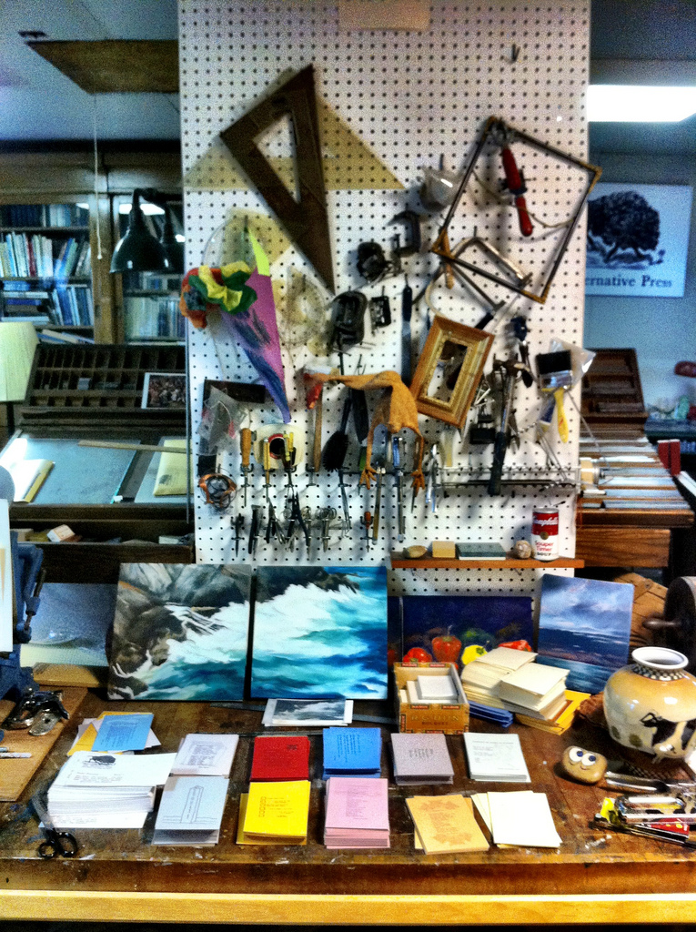
Ken Mikolowski (The Alternative Press Studio, Ann Arbor, Michigan)

Slide 13
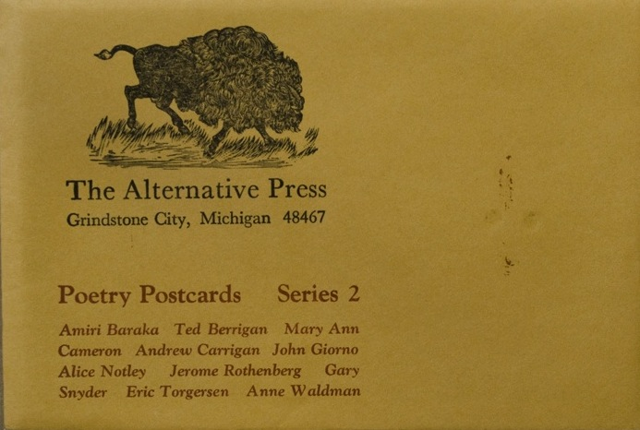
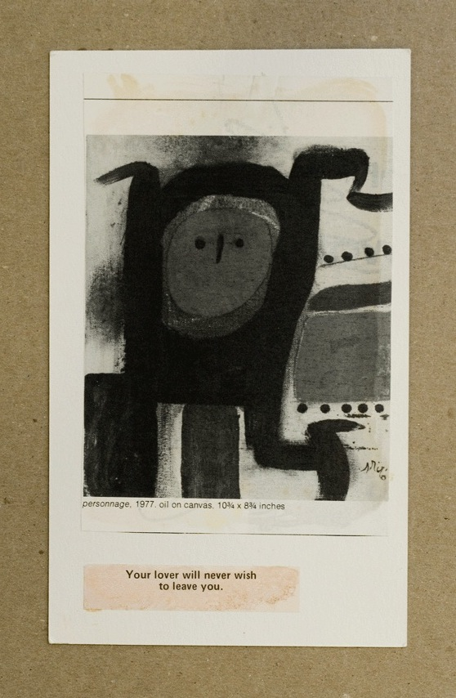
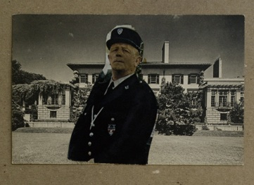
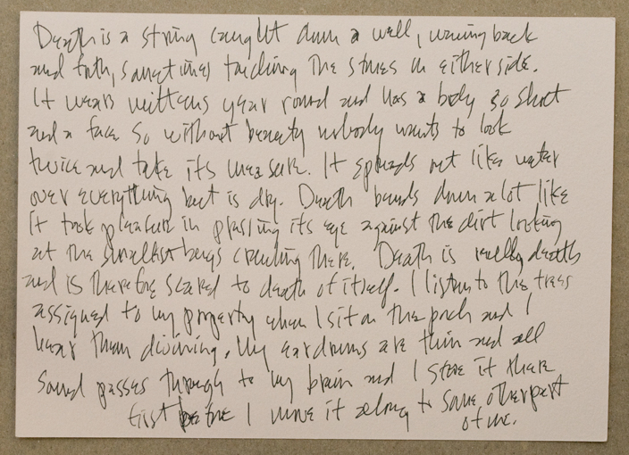
The Alternative Press Collection (Purdy-Kresge Library Periodicals, Wayne State University)

Slide 14
The Lotus Press
The Lotus Press was founded in 1972 by Detroit Poet Laureate and WSU graduate, Naomi Long Madgett. The Press evolved as a critical response to the lack of representation and visibility of African-American literature in the education system, and in later years, functioned to insure the integrity and independence of African-American poets, regardless of their style and subject matter. During the 1970s, first editions were produced by mimeograph, collated and bound by hand, and thereafter, by laser printer. The Press has made a significant contribution in both local and national contexts, and continues to operate today.
Detroit Poets: Naomi Long Madgett, Dudley Randall, Paulette Childress White,
Toi Derricote, Pamela Cobb, William J. Williams, Bill Harris, and others.
National Poets: Robert Hayden, Audre Lorde, Margaret Walker, Herbert Woodward
Martin, Lance Jeffers, James A. Emanuel, Houston A. Baker, Jr., and others.

Slide 15
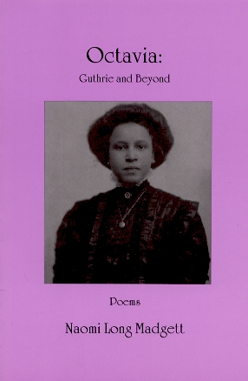
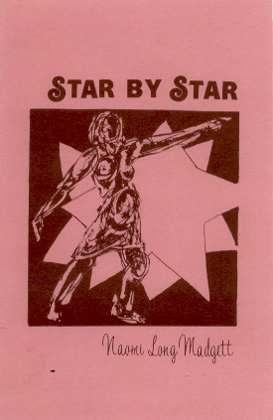
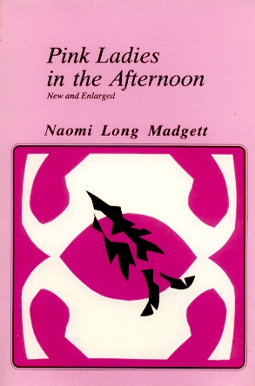
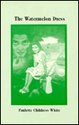
Naomi Long Madgett/Lotus Press Papers (Harlin Hatcher Graduate Library, Special Collections, University of Michigan)

Slide 16
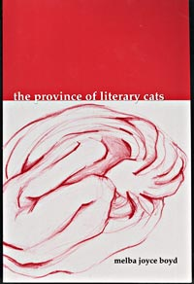
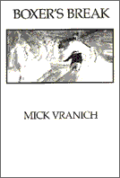
The Past Tents Press
The Past Tents Press is a non-profit small press founded in 1985 by Dennis Teichman, Paul Schwarz and Deb King to support and publish writers who live, work or have a history of involvement in Detroit's cultural communities.
Detroit Poets: Melba Joyce Boyd, Bill Harris, Kim Hunter, Greg Kiewiet, Ken
Mikolowski, Kofi Natambu, Ted Pearson, Leslie Reese, Chris Tysh, George Tysh,
Dennis Teichman, Mick Vranich, and others.

Slide 18
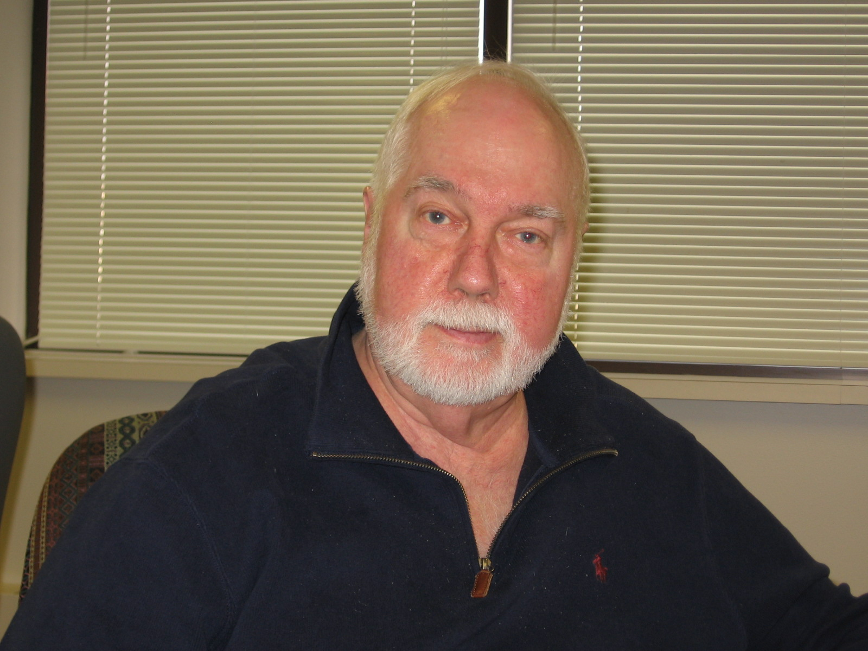
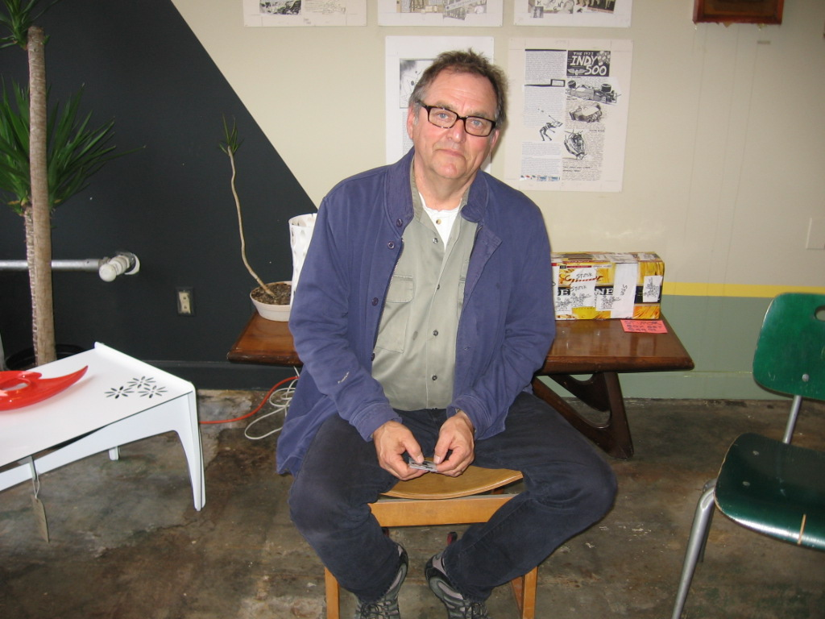
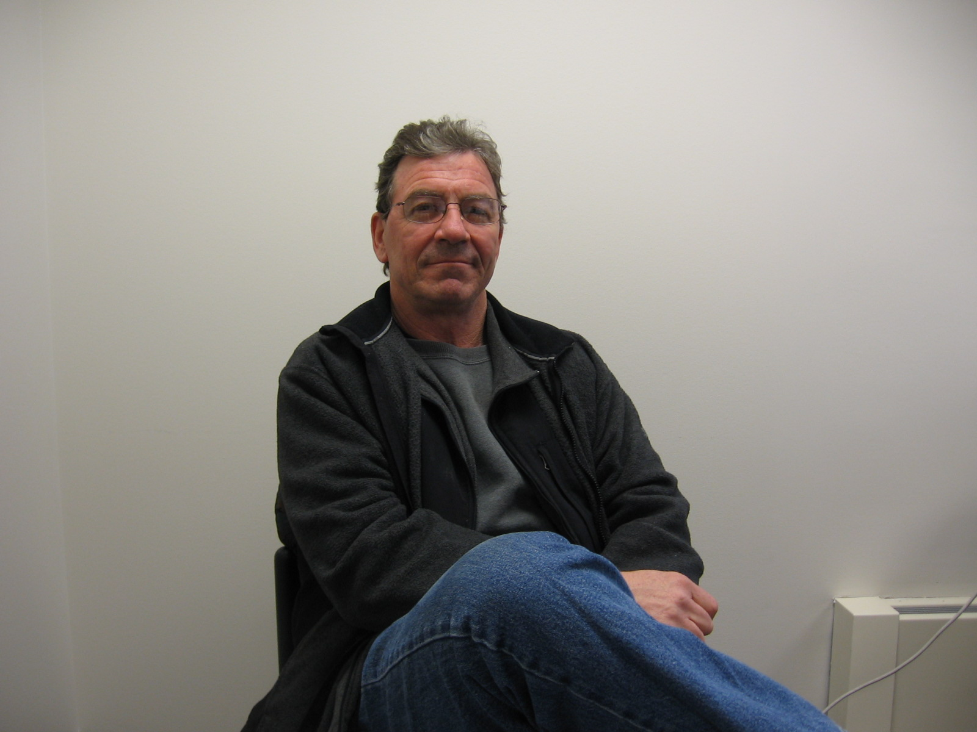
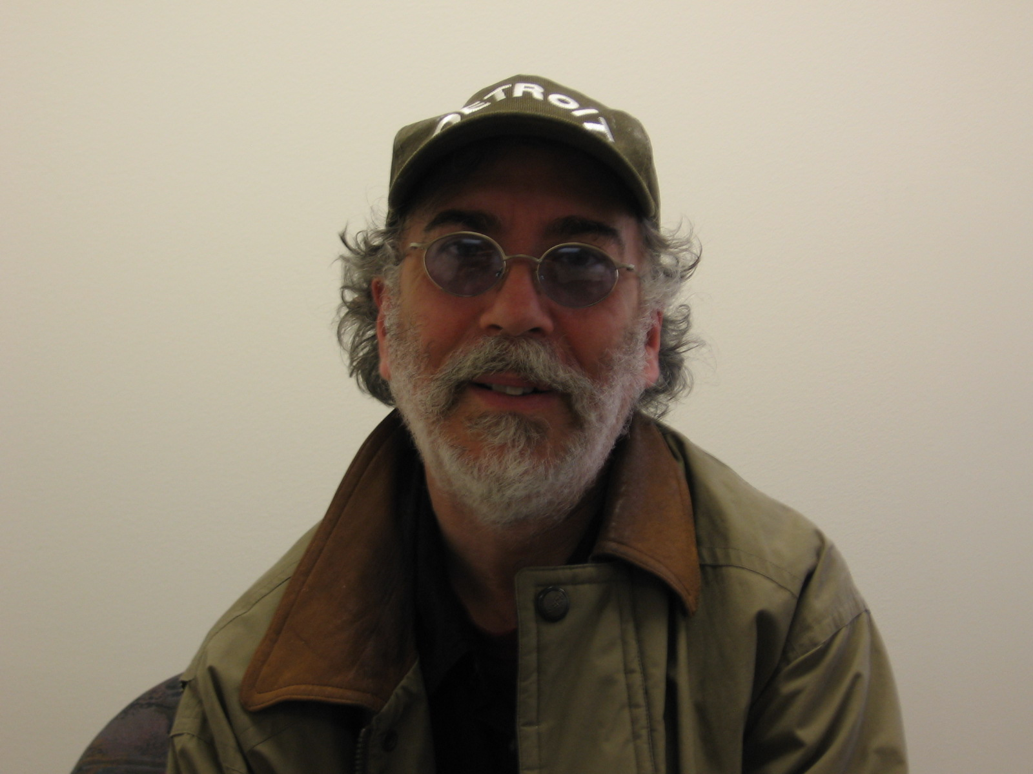
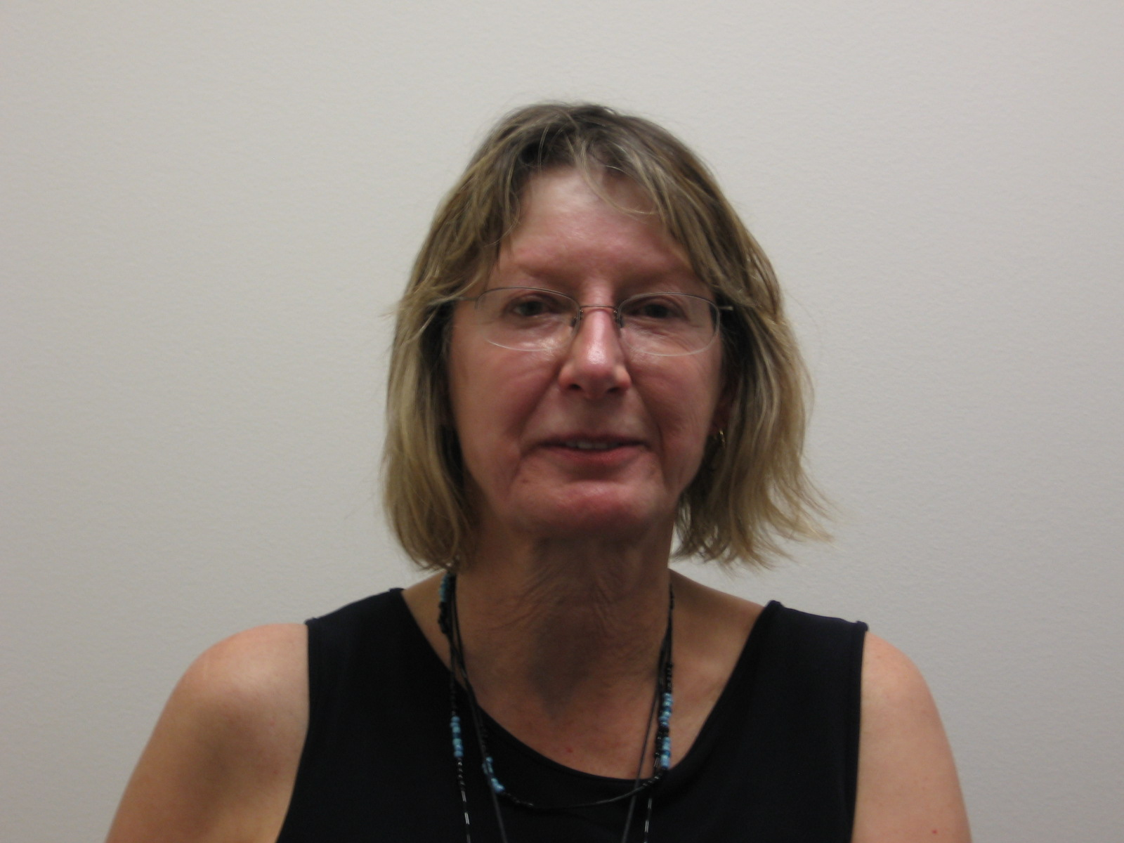
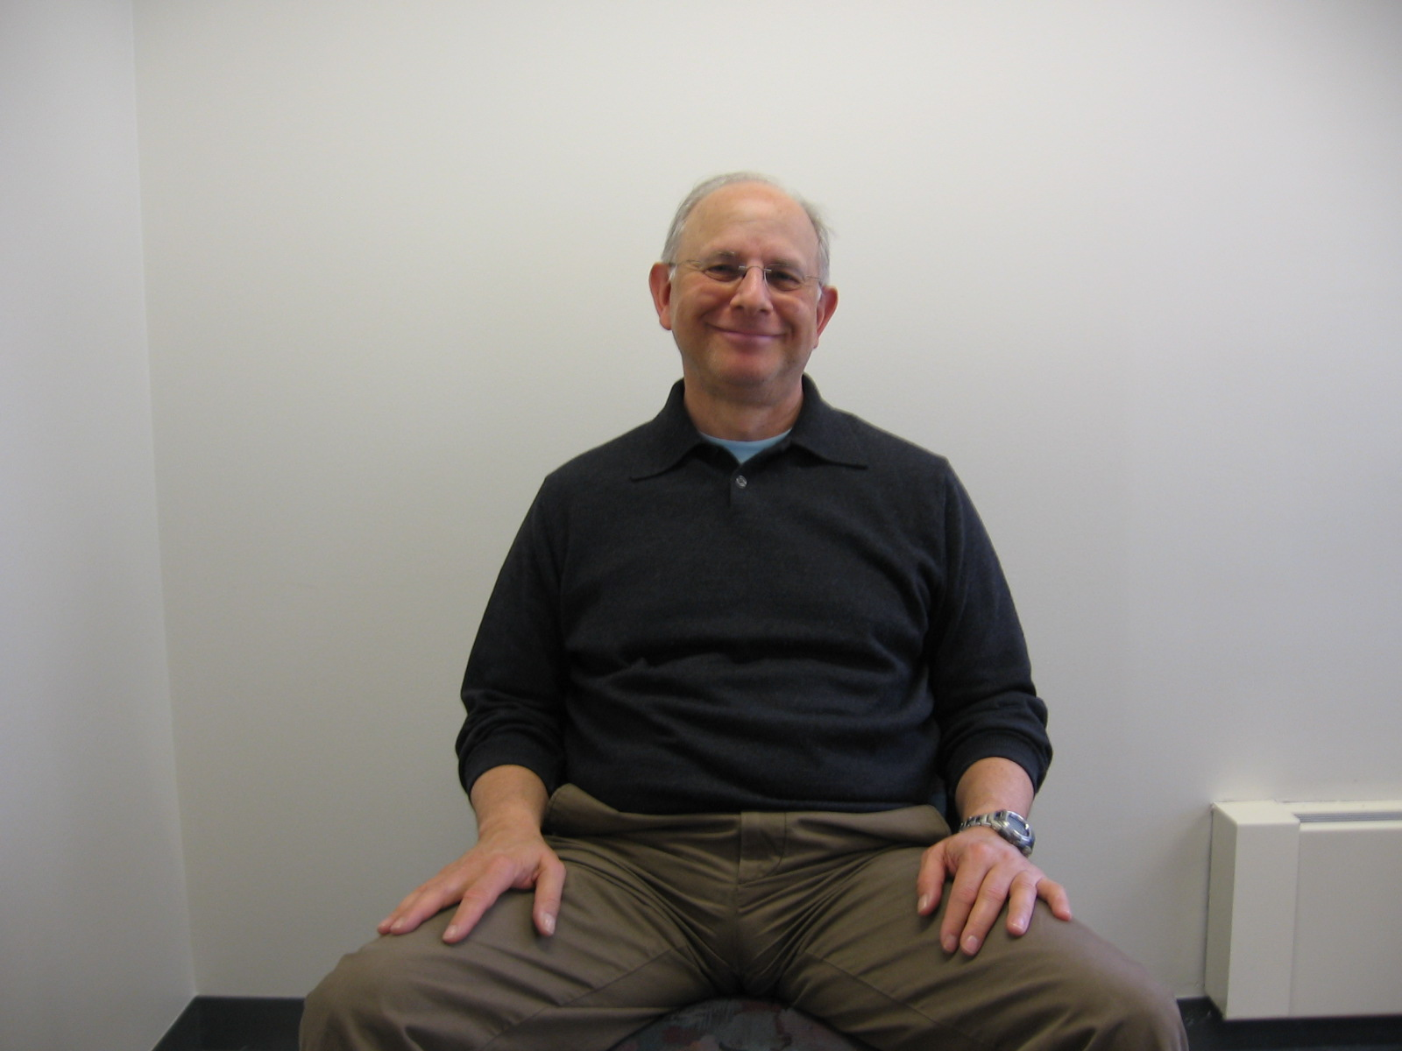

Slide 19
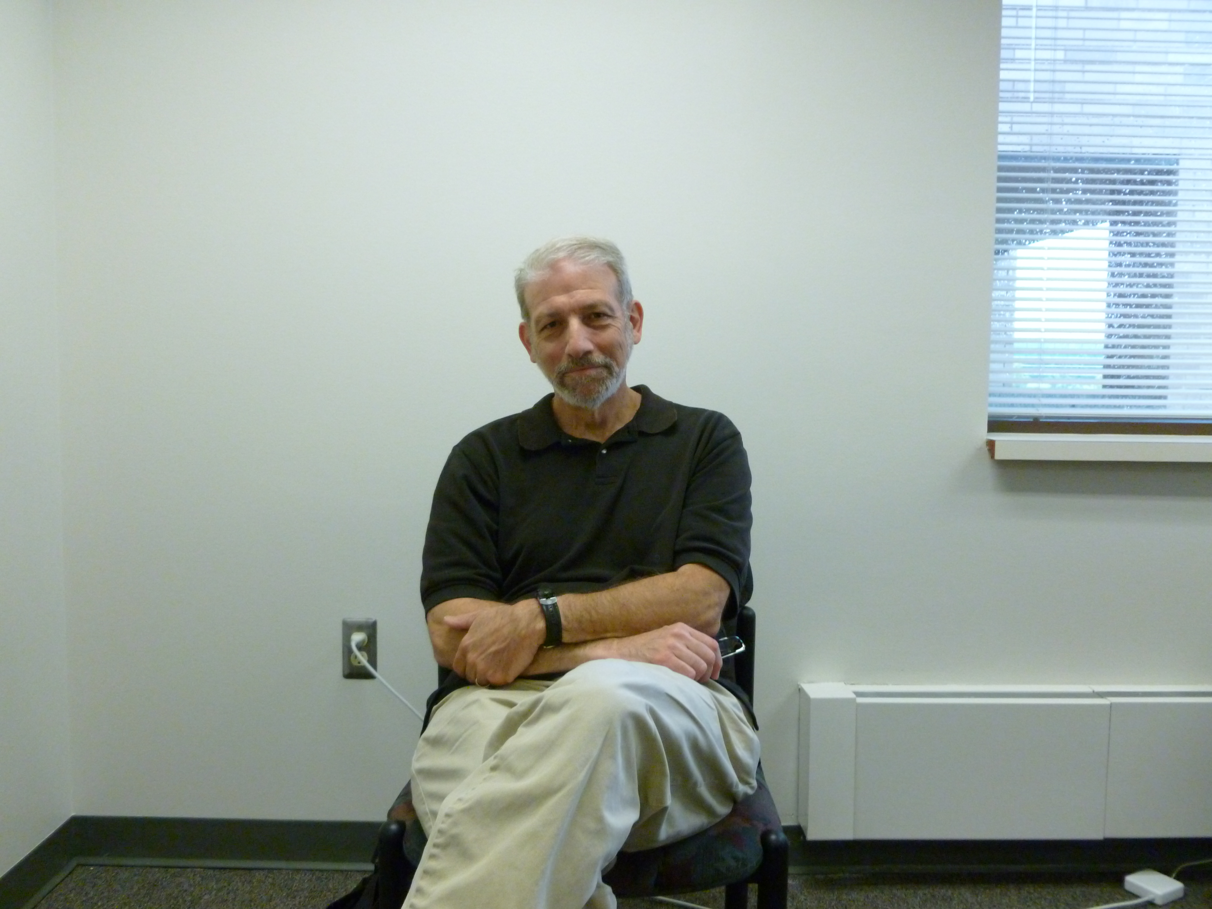
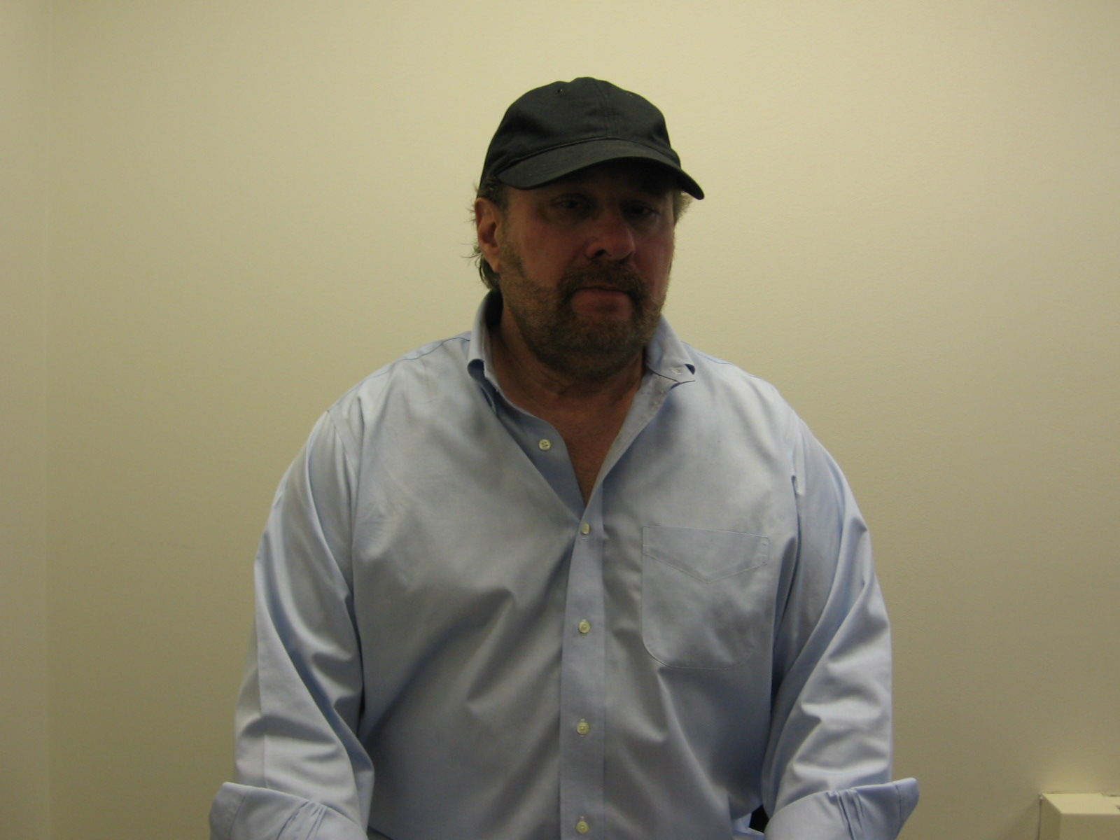

Slide 20
Quotations
“Detroit artists and writers have always taken the responsibility to nurture the next generation, sharing their knowledge of music, life, and moral responsibility.” Bill Harris
“Writing is part of a discussion. Jazz is part of a discussion. Play your poetry. Play your jazz. Engage the group…Jazz music has taught Americans how to live together; it spawned a democratic vision of America.” George Tysh
“Ones cultural context will determine artistic expression in form, content, and articulation….At Wayne State University, we had interethnic cultural interaction.” Melba Joyce Boyd
“Our poetry is liberating, defensive, functional, and political…I would love to be a threat to the government.” Ken Mikolowski

